Slide 1
Introduction to Bayesian Data Analysis
Suriyadeepan Ramamoorthy

Slide 2
Outline
Introduction to Bayesian Inference
Statistical Parameter Estimation : Chemical Activity Problem
Radioactive Decay Rate Estimation
Control vs Treatment Group Comparison : Drug-IQ Experiment
Hierarchical Modeling : Mosquito Repellant Study
Multi-group Comparison : Bacterial Culture Study
Model Checking : Posterior Predictive Check
Notes:
We’ll start with a short intro to Bayesian Inference
What kind of problems can Bayesian Estimation solve?
Parameter Estimation
Group Comparison
We’ll look at 5 examples and learn the concepts in bayesian data analysis
Chemical Activity Problem : Estimate IC50 (inhibitory concentration)
Estimate radioactive decay rate of an unknown radioactive material
Control vs Treatment Group comparison
Two group : special drug and other group given placebo
Hierarchical modeling is a special feature of bayesian modeling
Mosquito study in India
Extend to Multi-group comparison
15 strains of bacteria
Concentration of indicator compound
PPC : is the model right?
Our model is generative
Generate new datapoints
Respecify model

Slide 3
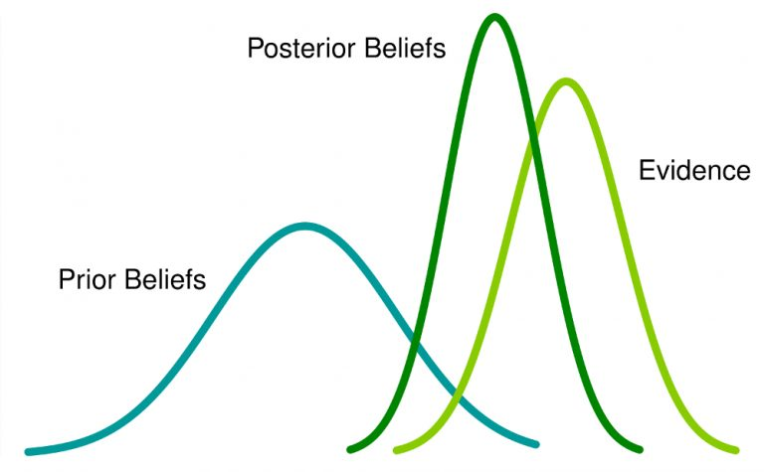
Bayesian Inference
Reallocate credibility across parameter values (possibilities)
Consistent with data
Notes:
We come up a bunch of hypotheses
Machine Learning selects the best hypothesis
But in reality, multiple hypotheses can explain the data
Bayesian Inference is all about reallocating credibility scores across possible hypotheses
Which explains data better?
What is the role of probability here?
We use probabilty theory as the language to express uncertainty in our model
Where do uncertainties come from?
What does the trained model look like?
The trained model runs predictions considering all the hypotheses
What if our set of hypotheses are wrong?
Model misspecification
Posterior Predictive check

Slide 4

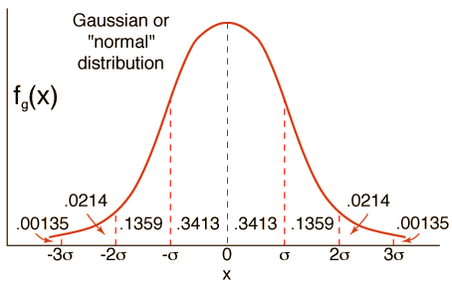
Probability Distribution
Centered on mean
Spread is given by Variance
Notes:
Just a quick intro to people who aren’t familiar with probability theory
How likely is each value?
Score for values from –inf to +inf
When you sample from this distribution, we are highly likely to get values closer to 0
0.5 is more likely than 100 or 1000
But it is possible to get a 1000 from this distribution as well.. Just super unlikely
0.5 and -0.5 are equally likely : symmetry
This is a normal distribution characterized by mean (mu) and variance (sigma)
Other distributions : Half-normal, Cauchy, Student-T distribution, Uniform

Slide 5
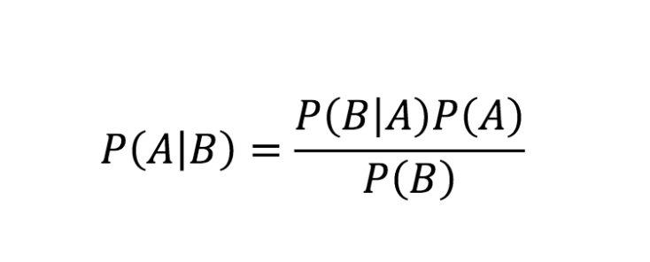
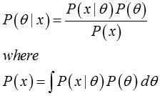
Bayes Rule
Notes:
This is the famous bayes rule
It can be easily derived from the basic Product and Sum rules
We reformulate it using theta and x
Theta denotes our parameters that define our model; We call P(theta) the prior;
Our belief about the model before looking at the data
We can encode our knowledge here
X denotes the data ; P(x) is the evidence
P(x | θ) is the likelihood function
The parametric function that is believed to have generated the data
Parameterized by prior
P(θ | x) is the posterior : updated belief after looking at the data
The evidence is given by the marginal probability
We have a bunch of data
But we don’t have a mechanistic model of the data generating distribution

Slide 6
Bayesian Inference
Prior : Prior belief about the nature of the parameters
Before looking at the data
Evidence : Available data (observed variables)
Likelihood : Parametric function that is believed to have generated the data
Posterior : Updated belief about the nature of the parameters
After looking at the data
Notes:
We start with the priors and likelihood and evidence
The priors encode our knowledge about the data generating process
We encode our uncertainty about the model in the priors
Likelihood is basically the form of model that generates the data
Bayesian Inference is all about going from Priors to Posteriors

Slide 7
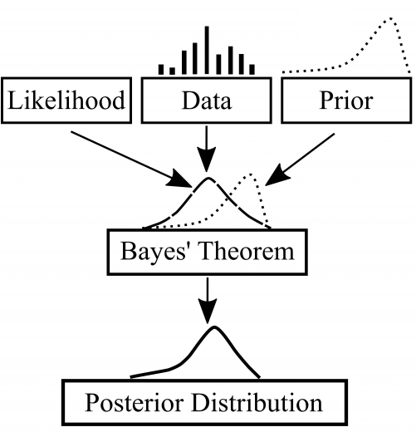
Bayesian Inference
Notes:
Bayesian Inference reallocates scores for each hypotheses after looking at data

Slide 8
Inference
Sampling
Markov Chain Monte Carlo (MCMC)
Exact, Slow
Variational Inference
Automatic Differentiation Variational Inference (ADVI)
Approximate, Fast
Notes:
There are two forms of inference
Both approximate the integrals using expectation – sampling
We can use MCMC for most cases
Model that are expensive can make use of Variational Inference
My Scipy talk is all about Variational Inference

Slide 9
Features
Incorporate Uncertainty
Include Prior Information
Common Sense
Mechanistic models
Hierarchical Modeling for Borrowing Strength
Notes:
What are the characteristics of Bayesian Modeling?
Ability to incorporate uncertainty in the model through the priors
Knowledge/Domain Expertise can be encoded
Common Sense
Existing Models
Hierarchical Modeling can share knowledge among groups
2 similar trials

Slide 10
Common Statistical Analysis Problems
Parameter Estimation
What is the IC50 of drug X ?
Group Comparison
Control vs Treatment
A/B Testing
Multi-group Comparison
Notes:
In A/B testing, we have two UI’s
Presented to users randomly
Estimate Click-through rate
Can be extended to multiple groups as we’ll see later

Slide 11
Parameter Estimation
Given the data, for the parameter of interest,
What is the probability distribution over the possible values?

Slide 12
Chemical Activity Problem
The IC50 (half maximal inhibitory concentration) is the concentration of an inhibitor where the response (or binding) is reduced by half.
IC50 of drug X is __________ (95% HPD : [lower, upper])

Slide 13
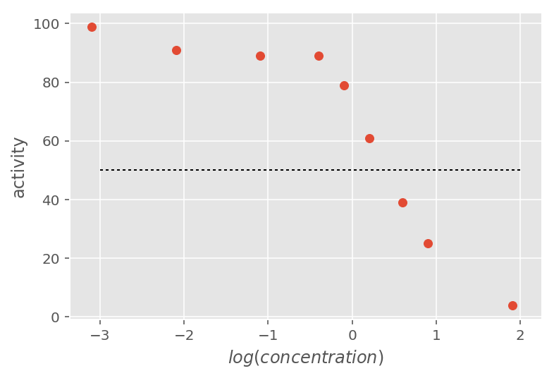
Chemical Activity Problem

Slide 14
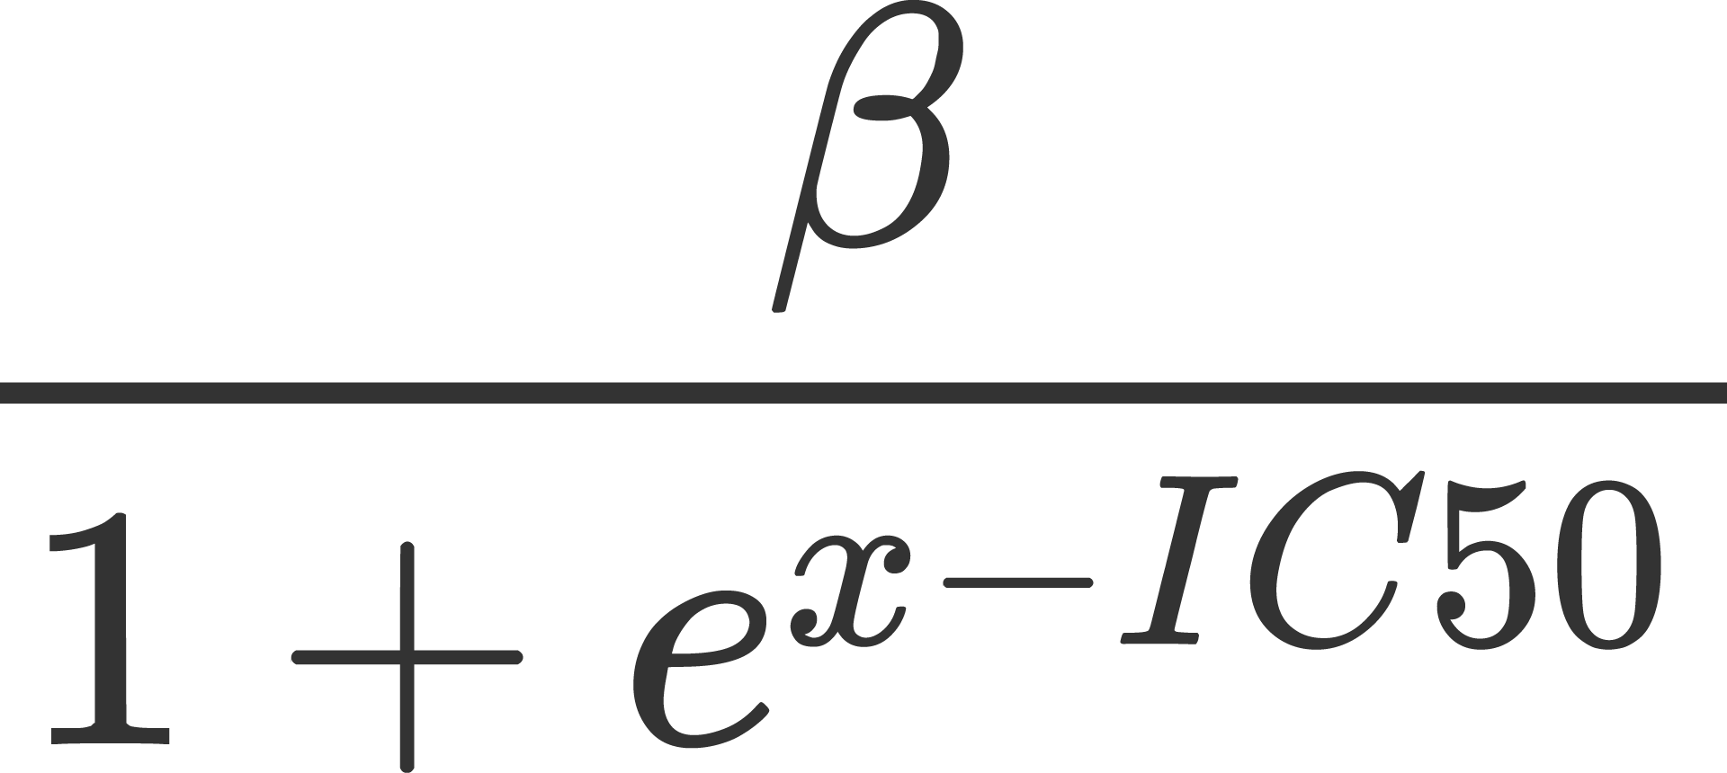
Decay Curve / Link Function

Slide 15
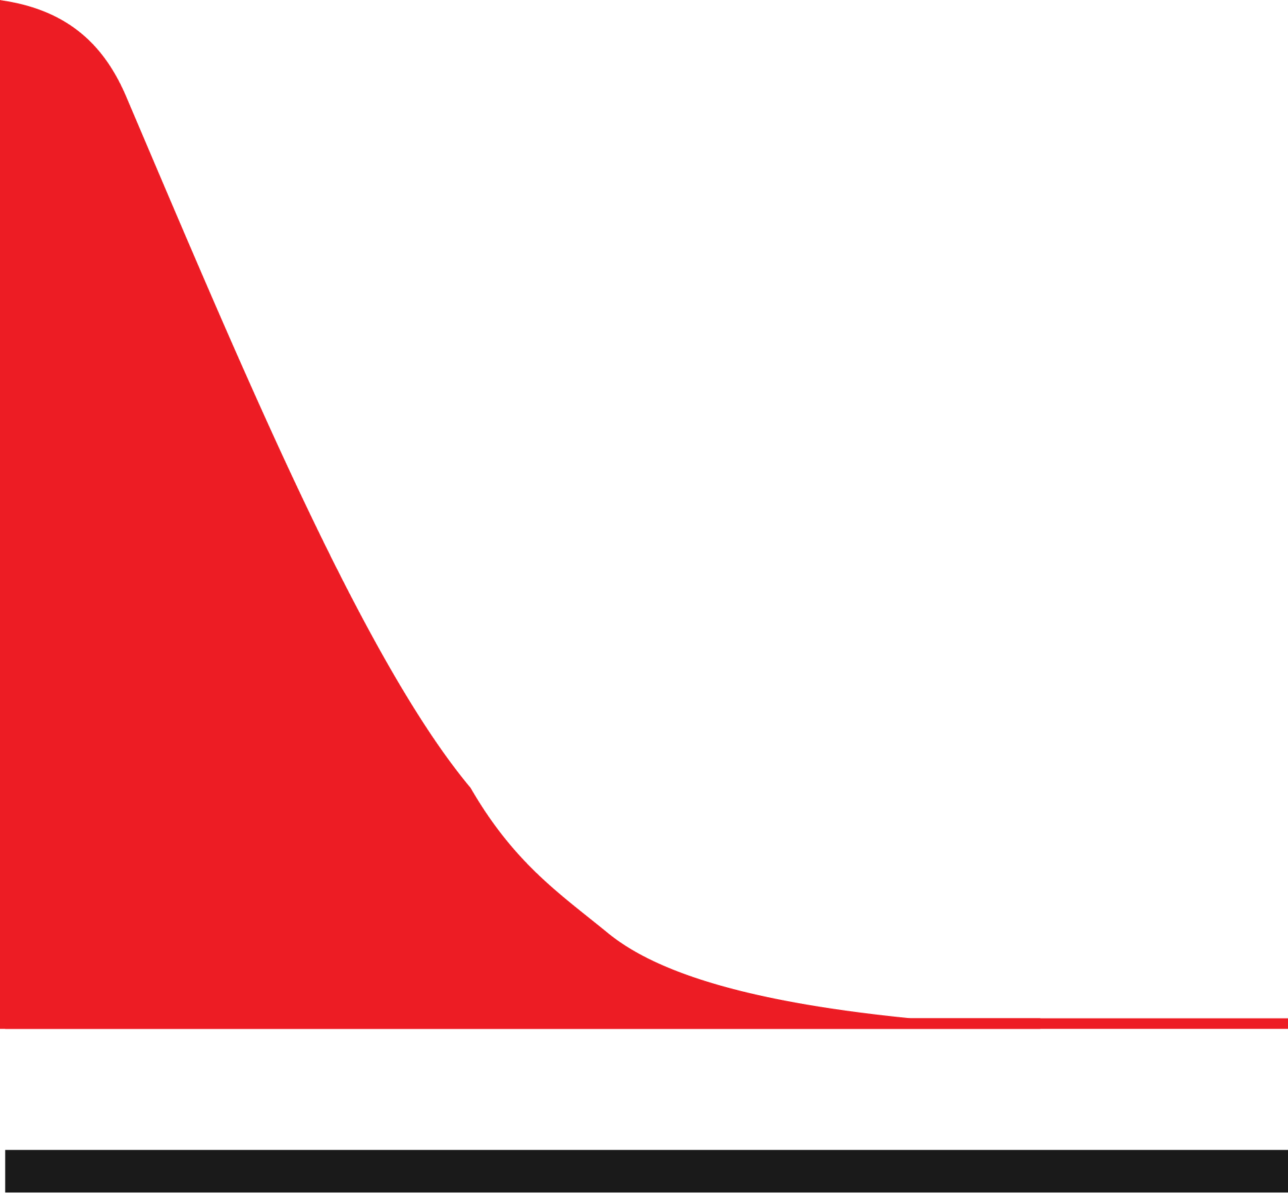

Bayesian Model Building
Priors
β
IC50
Likelihood
Link Function
Notes:
This is our data generation story
Informed by domain knowledge

Slide 16
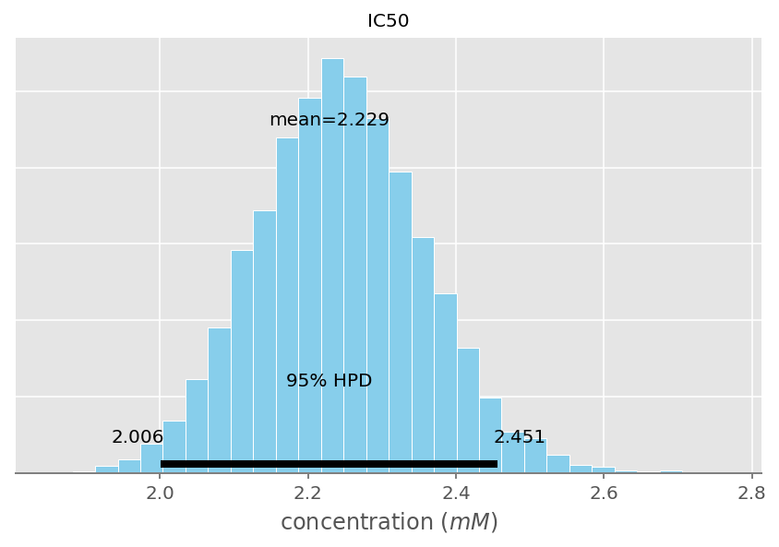
Estimate of IC50

Slide 17
Summary of Analysis
The IC50 is the concentration of an inhibitor where the response (or binding) is reduced by half.
IC50 of drug X is 2.229 mM (95% HPD : [ 2.0, 2.45 ])
Notes:
It’s a bad drug
2.229 mM is a large concentration of drug
Is this correct?
Do PPC : Generate new samples

Slide 18
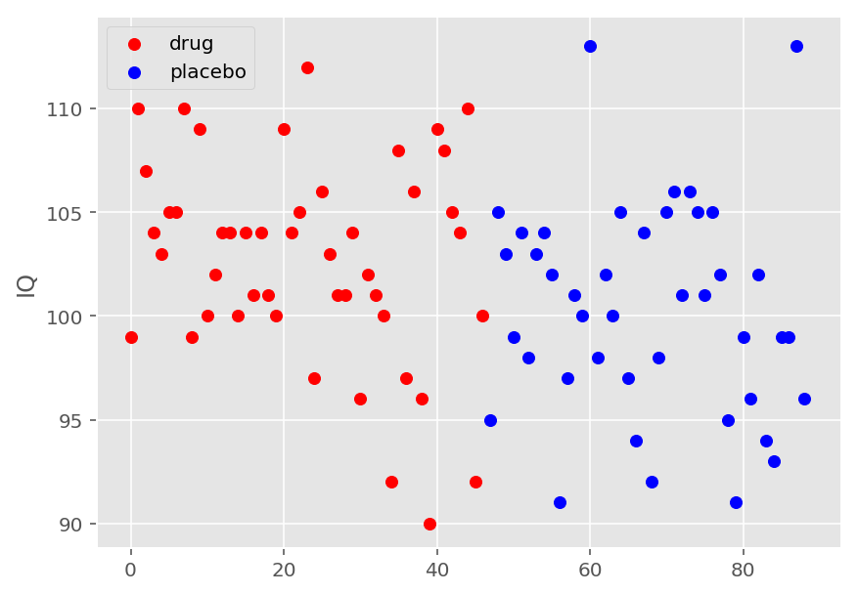
Drug-IQ Experiment
Notes:
Here’s the story
Two groups : one group was given a placebo (control) and the other the drug (treatment)
And here’s the question

Slide 19
Drug-IQ Experiment
Is there a significant difference between the drug-treated and placebo-treated participants?
Notes:
Just by looking at the data, we don’t know
We use Bayesian Modeling to navigate this uncertain terrain (trail off)

Slide 20
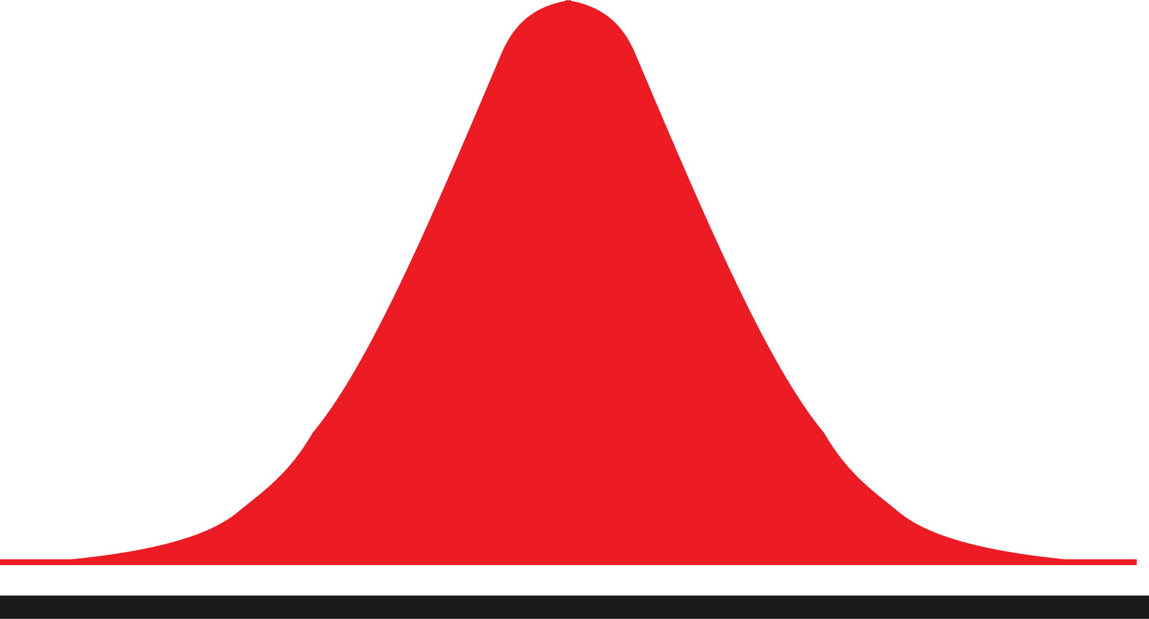


Model Building
Priors
mu_ : Normal
sigma_ : Half-Cauchy
nu : Exponential
Likelihood : Student-T distribution
Notes:
Priors groups for each

Slide 21
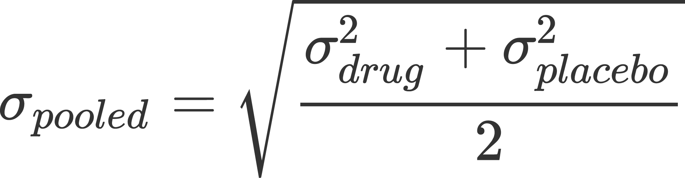
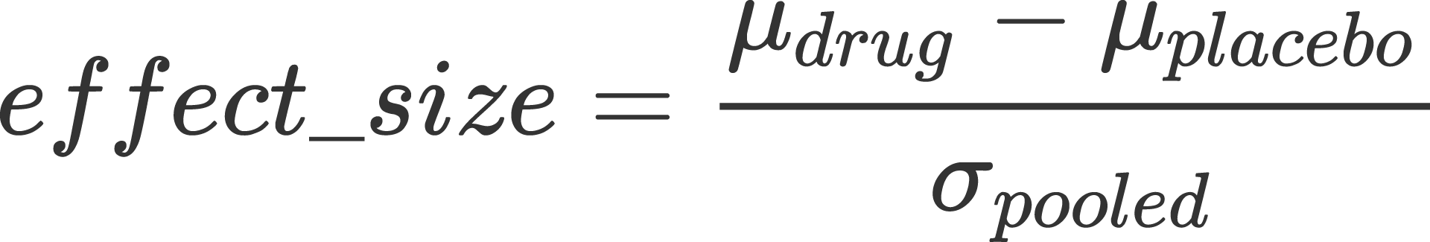
Metrics
Pooled Standard Deviation
Effect Size

Slide 22
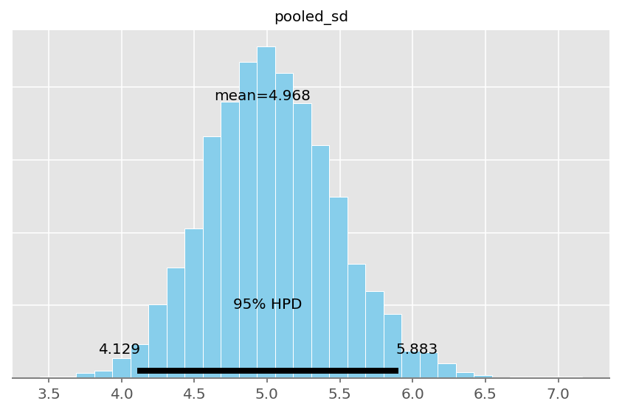
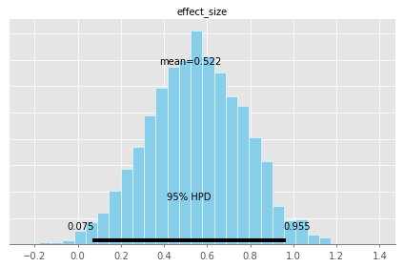
Metrics

Slide 23
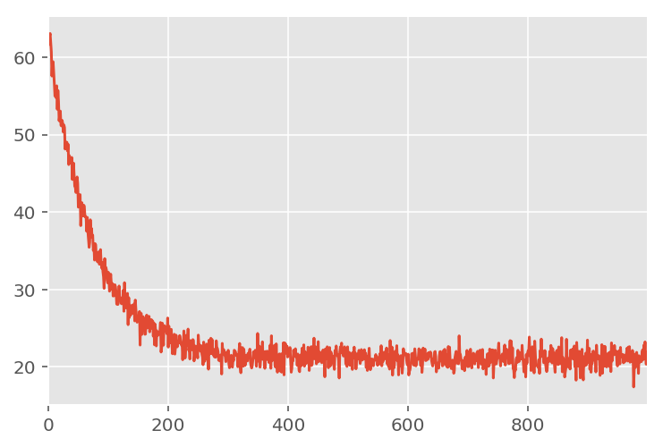
Radioactive Decay Rate Estimation

Slide 24

Decay Rate Equation

Slide 25
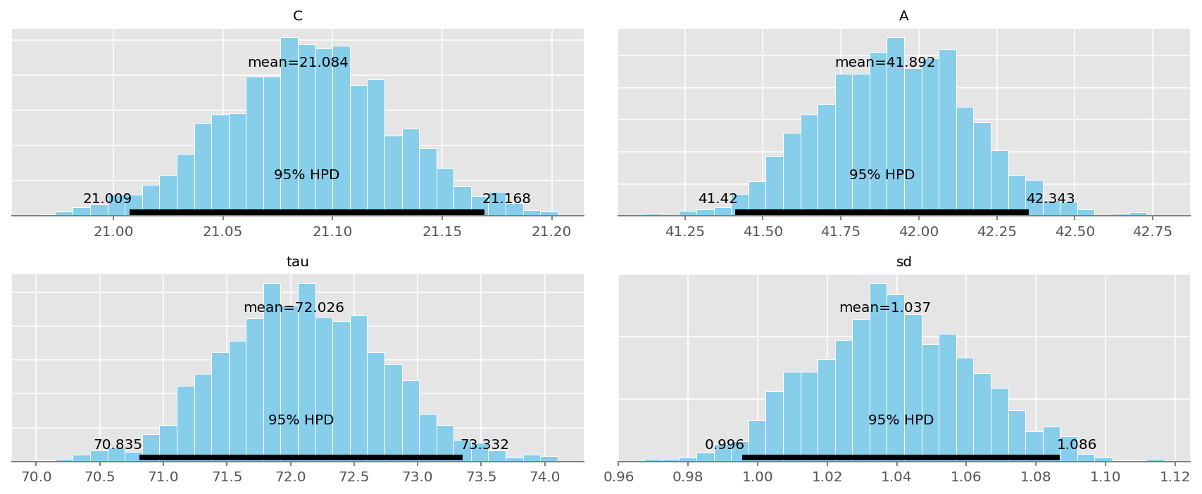
Estimated Parameters

Slide 26
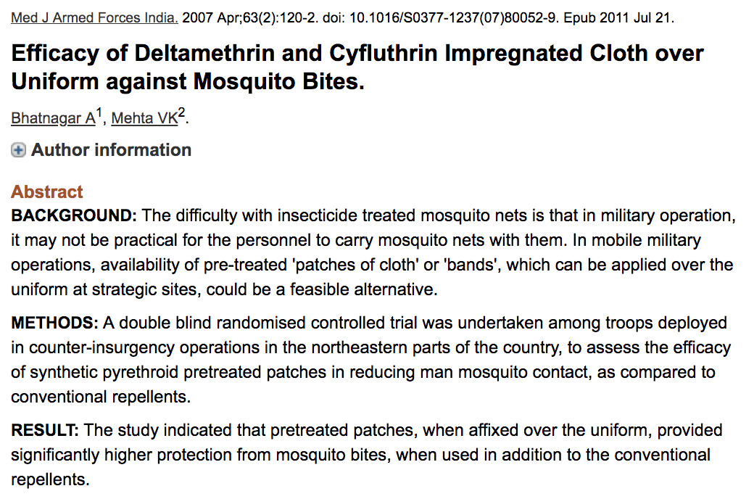
Mosquito Repellant Study

Slide 27
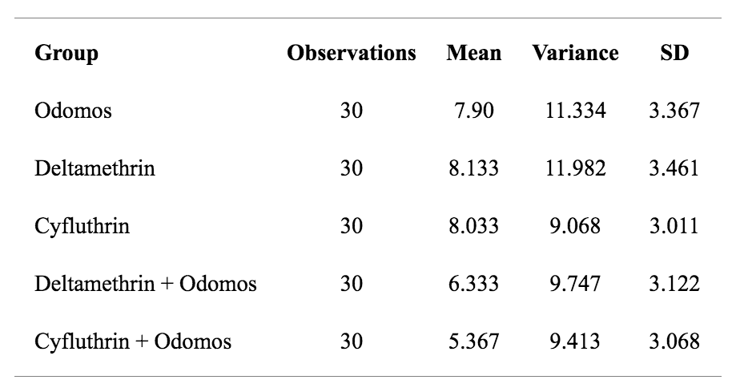
Mosquito Repellant Study

Slide 28
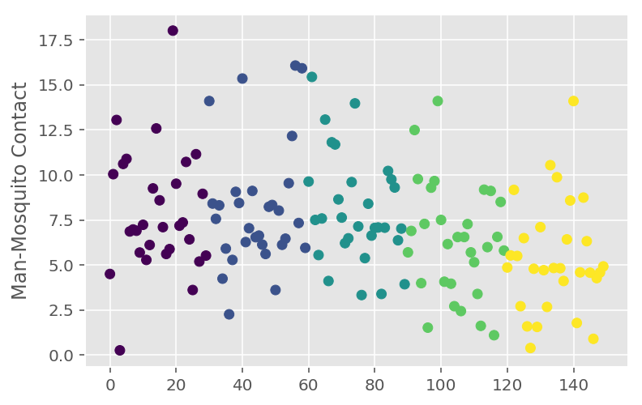
Mosquito Repellant Study

Slide 29
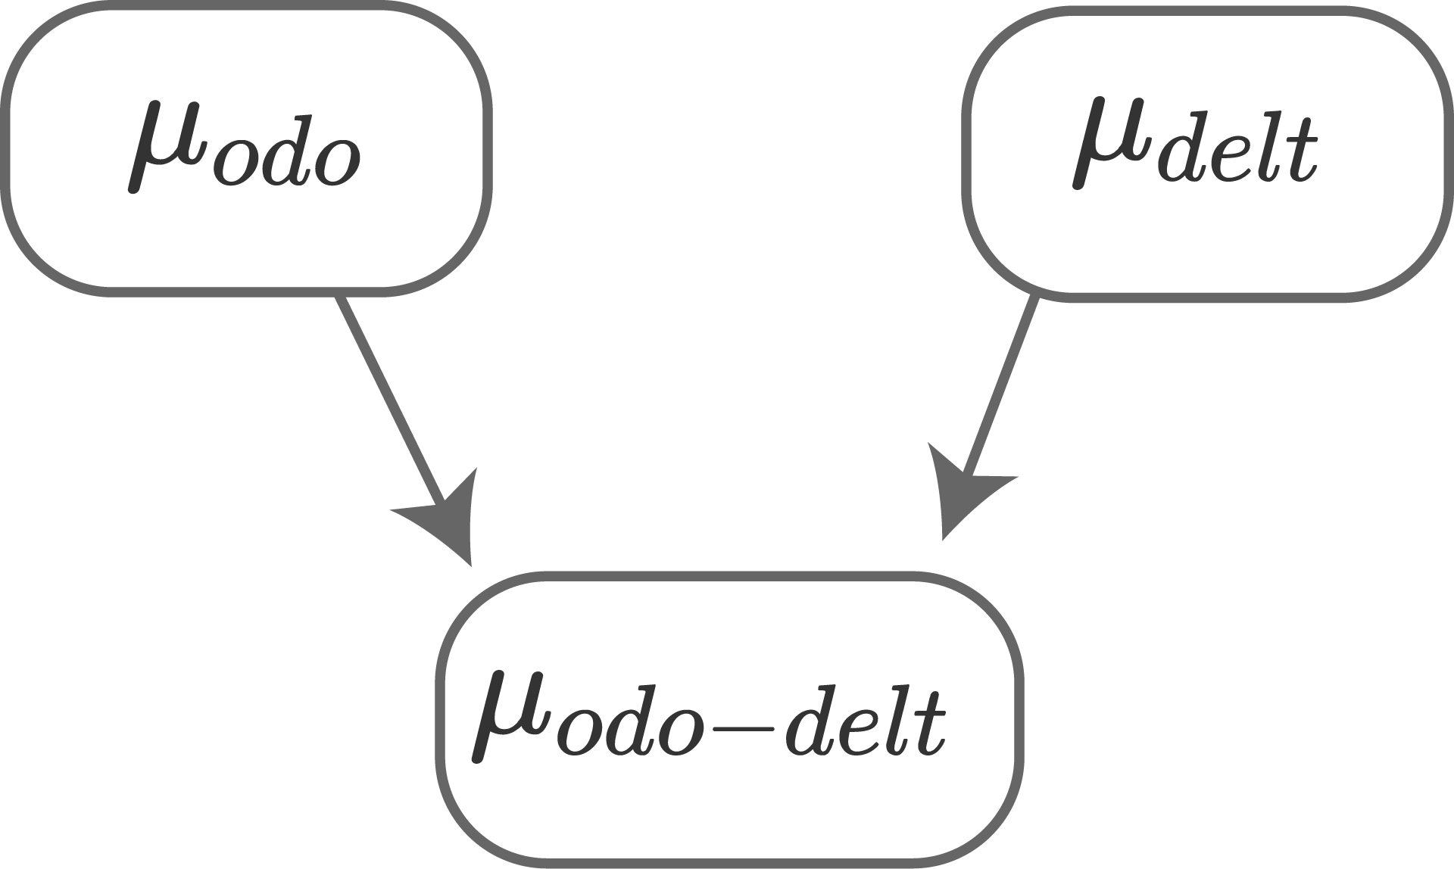
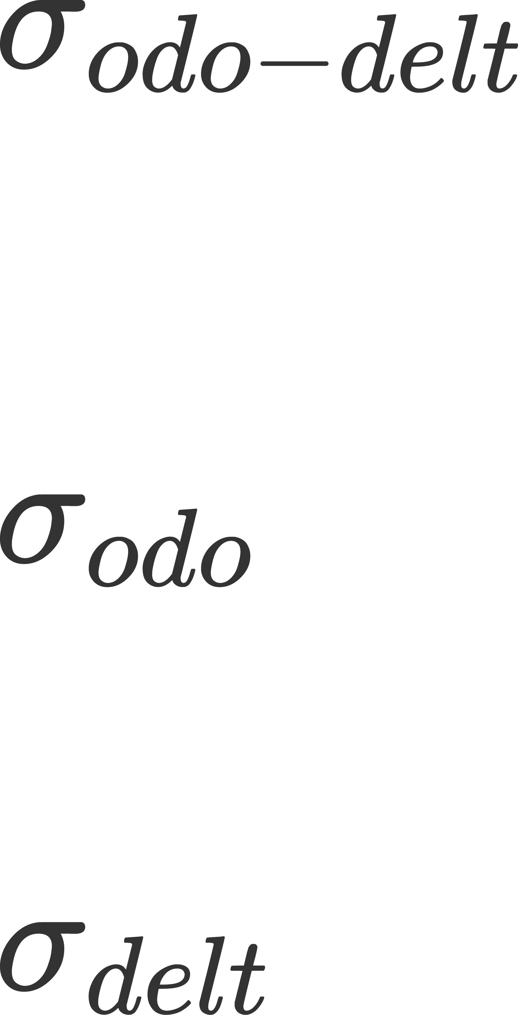
Hierarchical Modeling

Slide 30
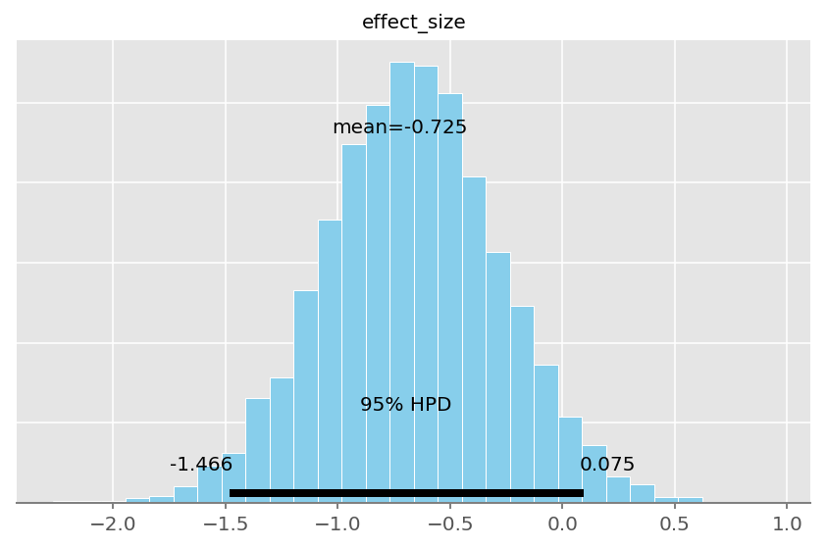
Mosquito Repellant Study : Summary

Slide 31
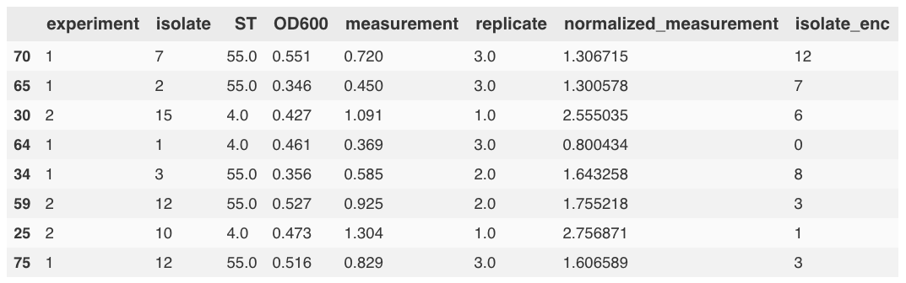
Bacterial Culture : Multi-Group Comparison

Slide 32
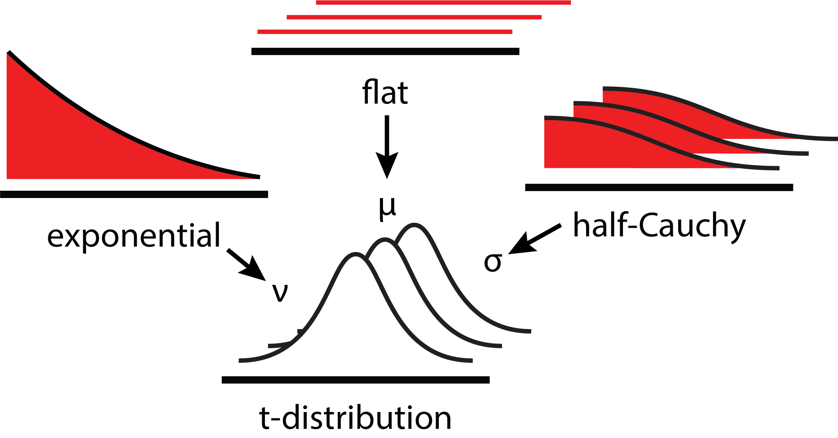
Bacterial Culture : Model Building

Slide 33
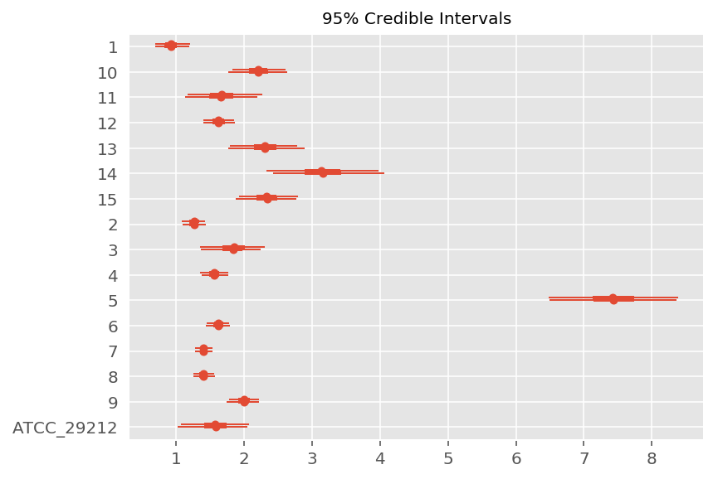
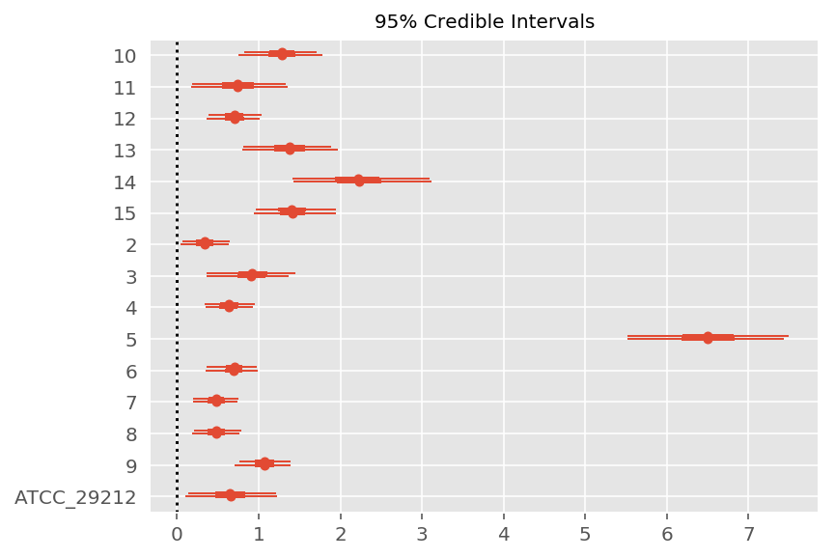
Bacterial Culture : Results

Slide 34
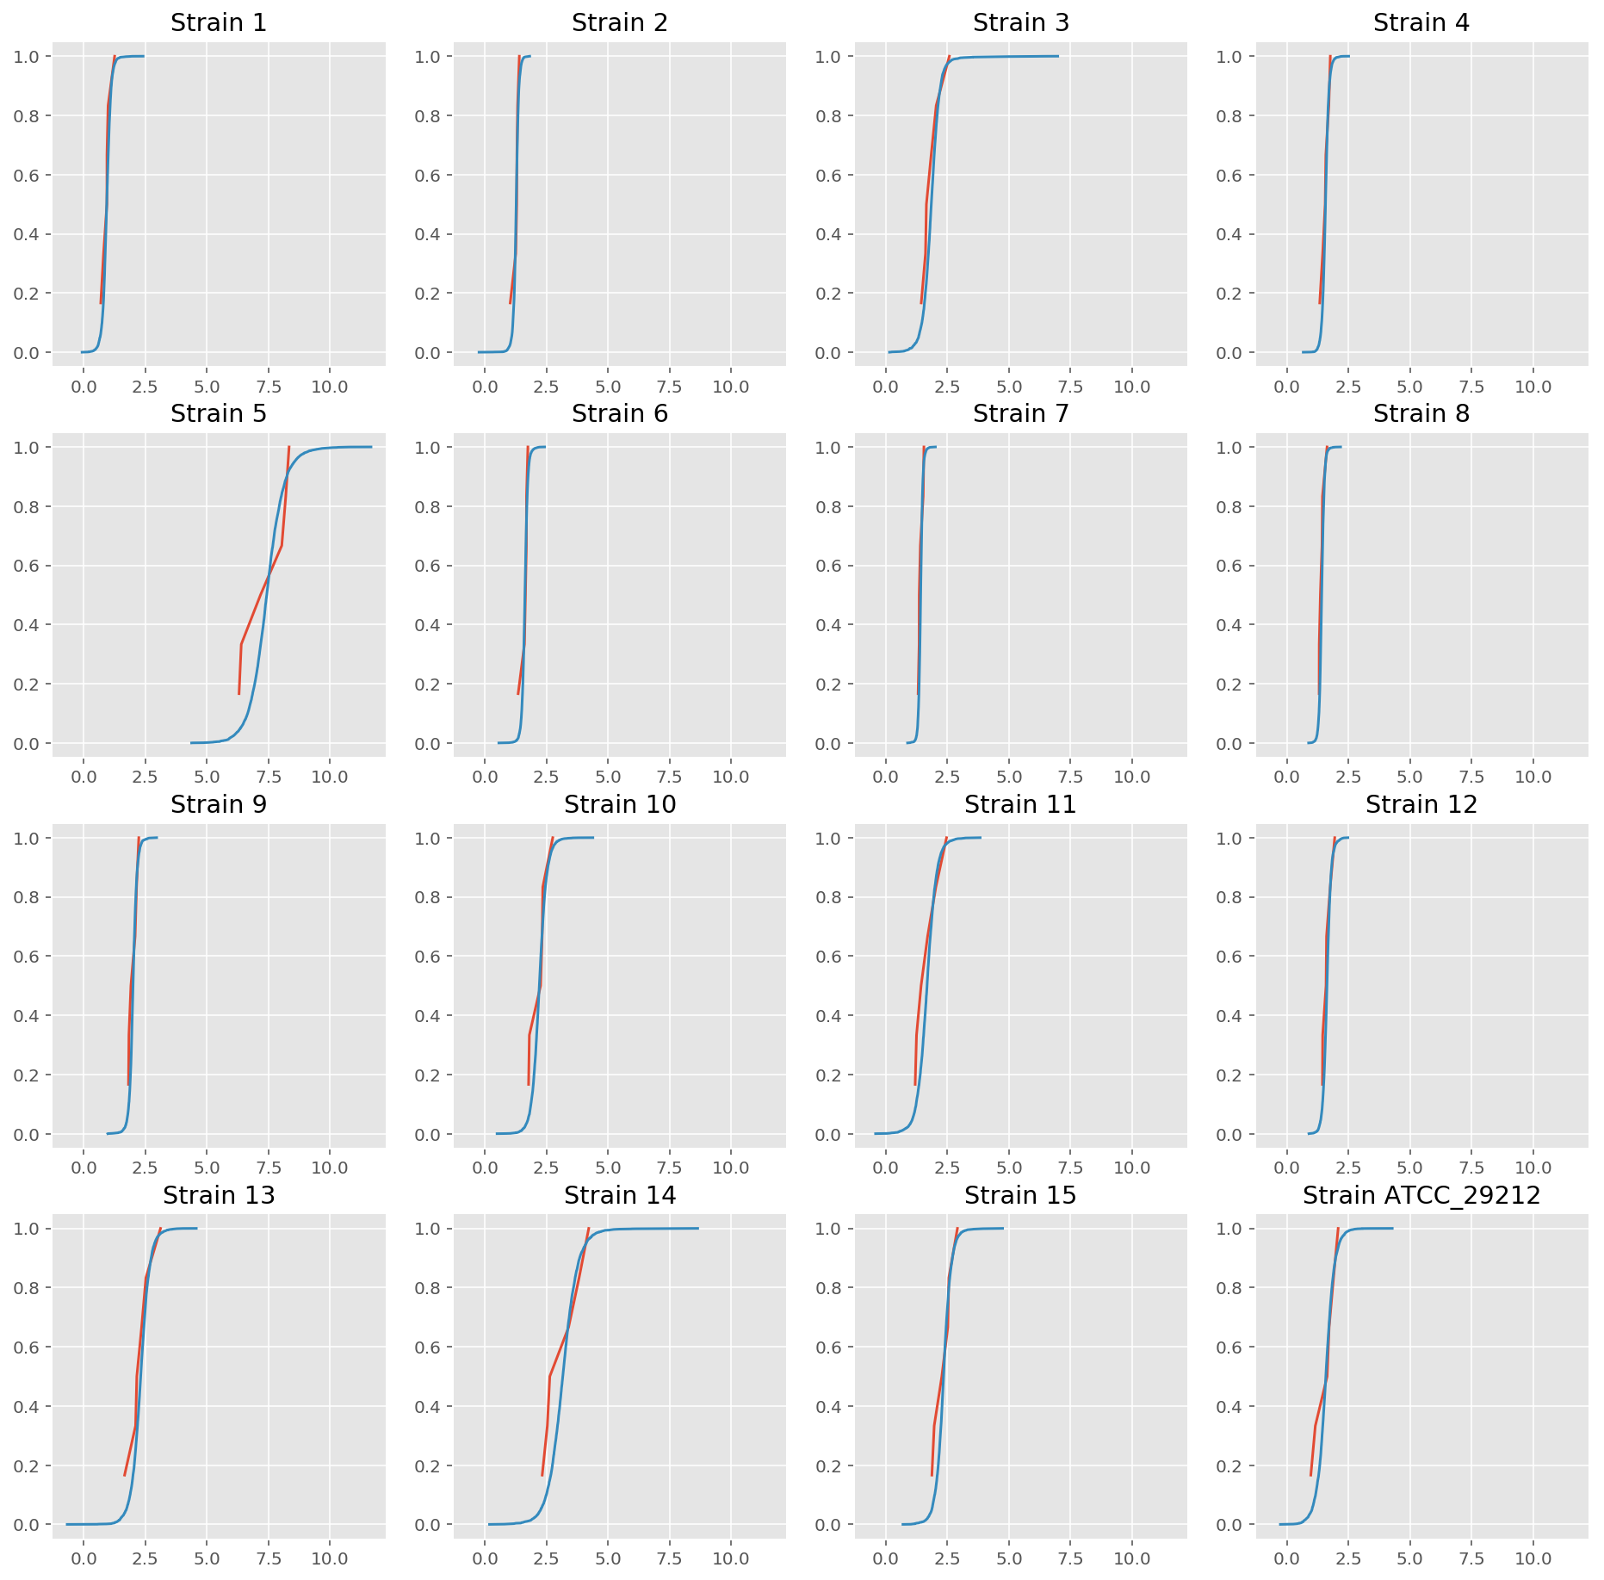
Posterior
Predictive
Check
(PPC)

Slide 35
Thanks!

